Slide 1
Introduction to JavaScript, Json, TypeScript, TSX
Cours Esilv 2024
arnaud.nauwynck@gmail.com

Slide 2
Outline
JavaScript
JSON
TypeScript
TSX

Slide 3
JavaScript
Java Script
Syntax inspired from "Java"
(itself inspired from "C", "C++")
untyped at compile-time,
interpreted at runtime
like "script" shells.
only "string", "numeric", boolean".
no "class" or type declarations !

Slide 4

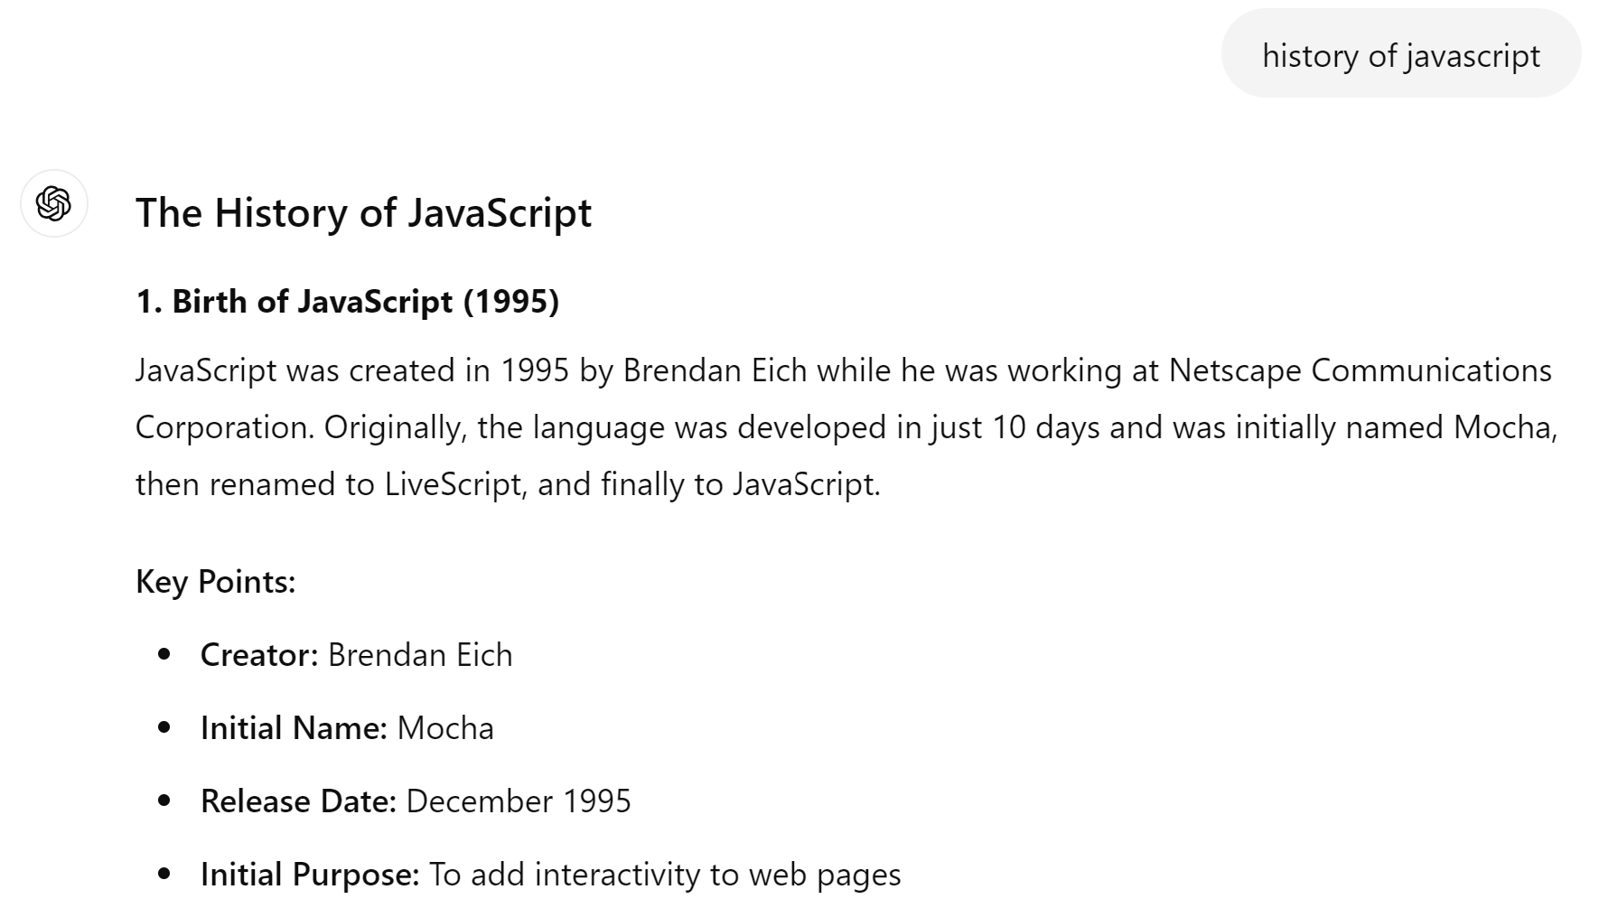
Birth of JavaScript : 1995

Slide 5
JavaScript Evolution
1995
1997
2005
2009
2012
2015
Adopted by browsers, but not standard
submitted to ECMA international
for standardisation
spec : "ECMAScript"
AJAX and Web 2.0
standardisation of browsers
ECMAScript 5
strict mode, JSON, ...
birth of many frameworks
(jQuery, AngularJS, etc..)
birth of Node.JS
server-side JS
development ecosystem (npm, grunt, gulp, ..)
ECMAScript 6 (=2015)
class, arrow, modules, ...
Birth of JS
used in
Netscape
web browser
TypeScript

Slide 6
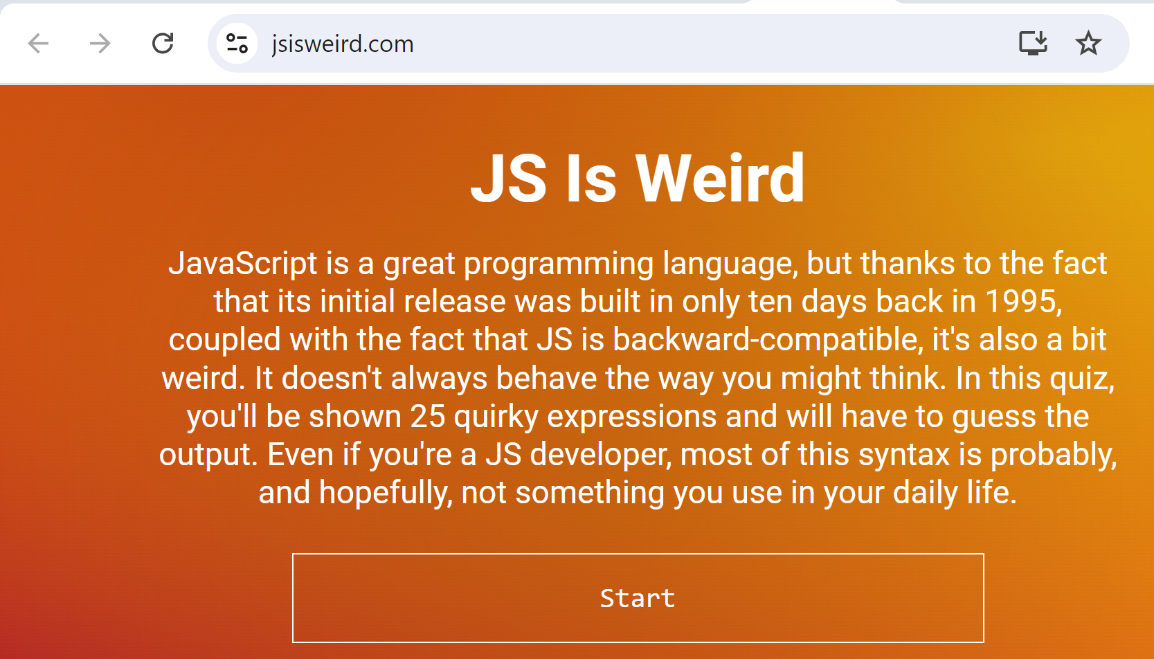
developed in 10 days by 1 person ... => explain many weird parts of the langage
https://jsisweird.com/

Slide 7
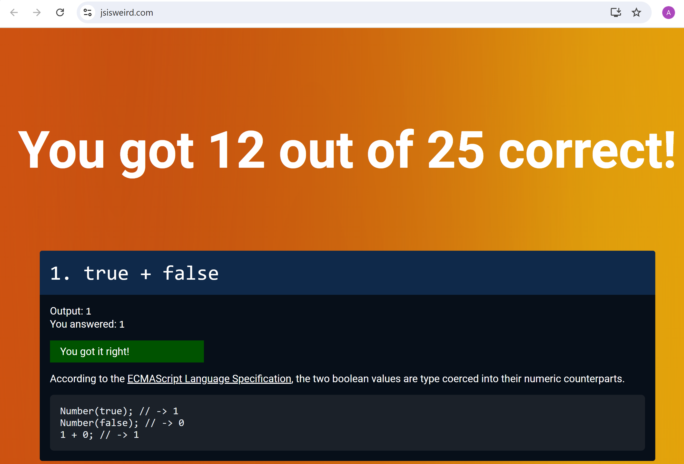
even for me
There are (strange) implicit coercions between primitive types...
For exact comparison, use "===" ( "==" may introduce conversions )

Slide 8
JavaScript = un-maintainable code !!
NO Type !! .. alternative like Google Dart since 2011 (ex in Flutter)
.. work-around since 2012 via TypeScript NO Class ! .. work-around since 2012 via TypeScript .. ok since 2015 EcmaScript6

Slide 9
Runtime Implementations
1998
2008
2009
2013
2020
Netscape
Firefox
Chrome (=v8)
Opera (=v8)
Edge (=v8)
Node.JS (=v8)
Mozilla
Open-Source
organisation
created from
Netscape Company
Firefox from
Nescape Navigator
Internet Explorer
Node.JS re-use the same runtime
as Chrome : "V8"
IE had is own runtime.
his own non-standard specs
=> lot of behavior differences
jQuery was a hack for compatibility
many browsers followed
(Opera in 2013, Edge in 2020, ...)

Slide 10
JavaScript Primitive Value Objects
null
undefined
String
Numeric
Boolean

Slide 11
Nested Compositions: [Array], {Object}
Array
Object

Slide 12
JSON = JavaScript Object Notation
NO code, only Value
Can be integrated directly in JavaScript (or TypeScript)
=> SUPER Easy for Http Rest using JSON as data encoding protocol
in pure JSON, identifier need to have double-quotes
... NOT needed in Js/Ts

Slide 13
JSON Example
{
"a": null,
"b": undefined,
"c": 123,
"d": true,
"e": "text with escaped \" and \n chars",
"f": [ null, undefined, 123, true, [], {} ],
"g": { "subField": 1, "b": true }
}

Slide 14
Example Unquoted JSON directly in JavaScript
let obj = {
a: null,
b: undefined,
c: 123,
d: true,
e: "text with escaped \" and \n chars",
f: [ null, undefined, 123, true, [], {} ],
g: { subField: 1, b: true }
};

Slide 15
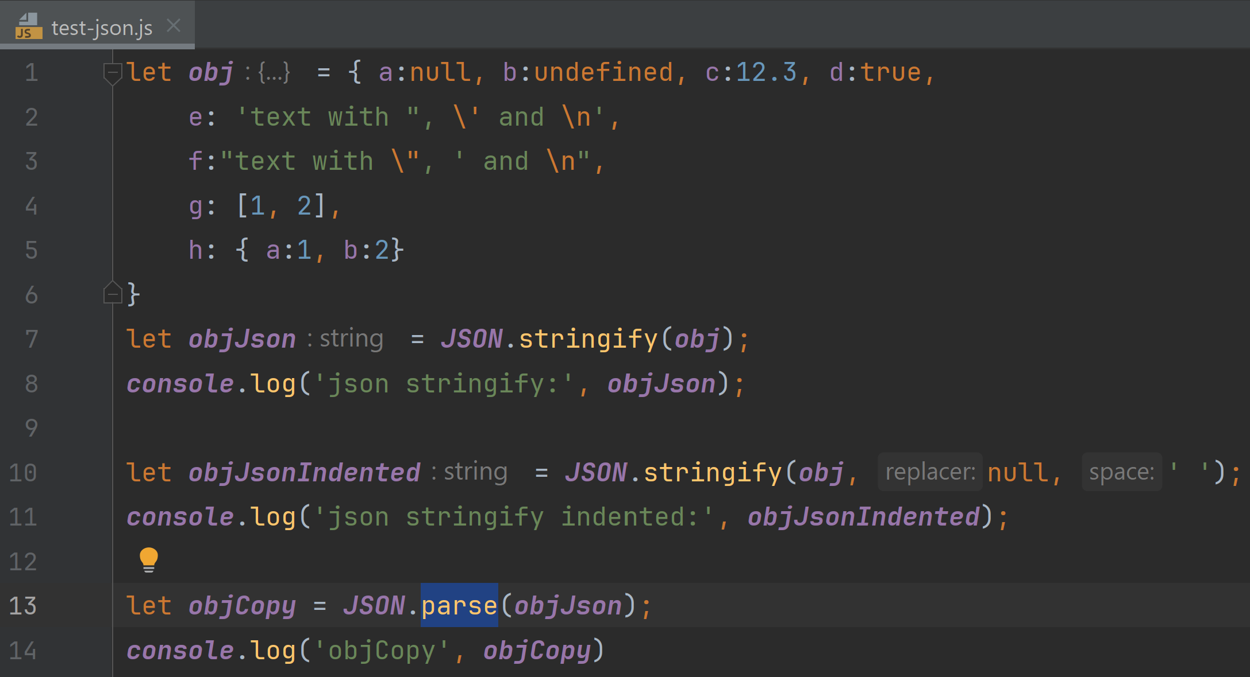
JSON stringify() / parse()... builtin in JavaScript

Slide 16
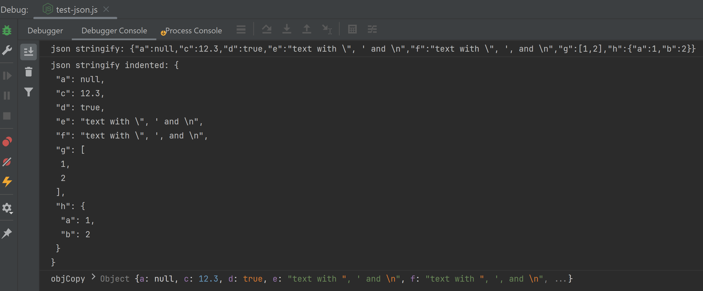
JSON.stringify(obj), .parse(text)

Slide 17
JavaScript object deep clone

Slide 18
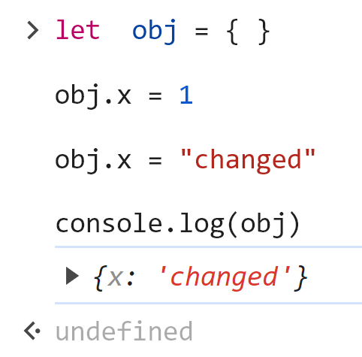
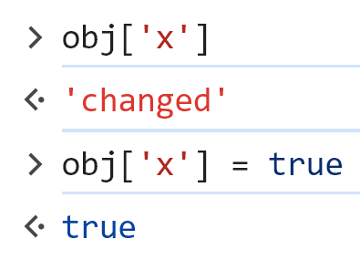
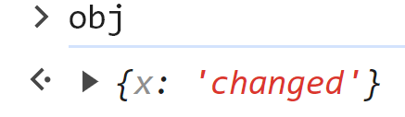
Objects (~= LinkedHashMap<String,*>)
using field Array notation :

Slide 19
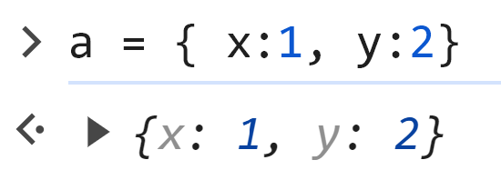
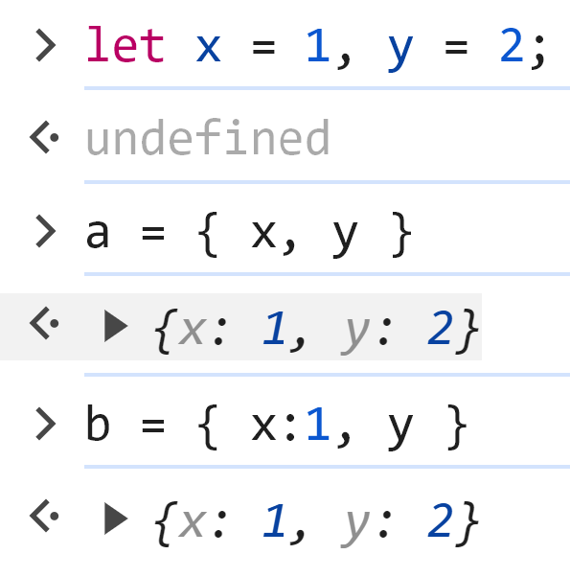
Creating Object with Field Values
Equivalent Code in Java
a = new LinkedHashMap<String,Object>();
a.put('x', 1); a.put('y', 2);
avoid stamming { "x": x, "y": y }
or { x: x, y: y }

Slide 20
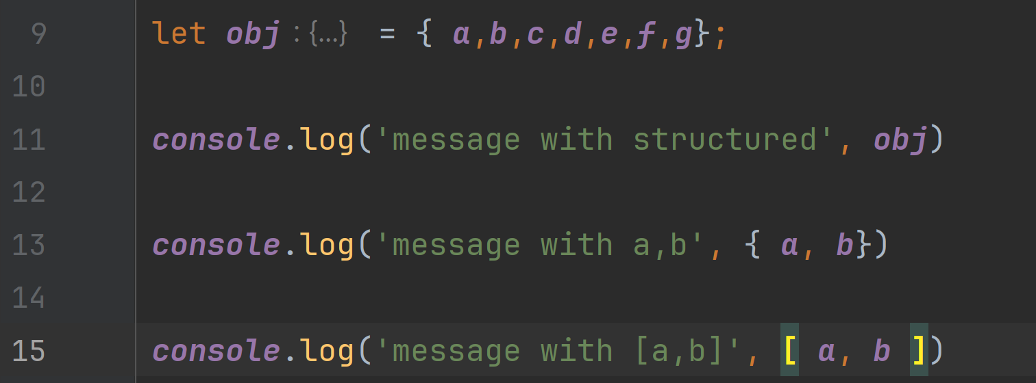
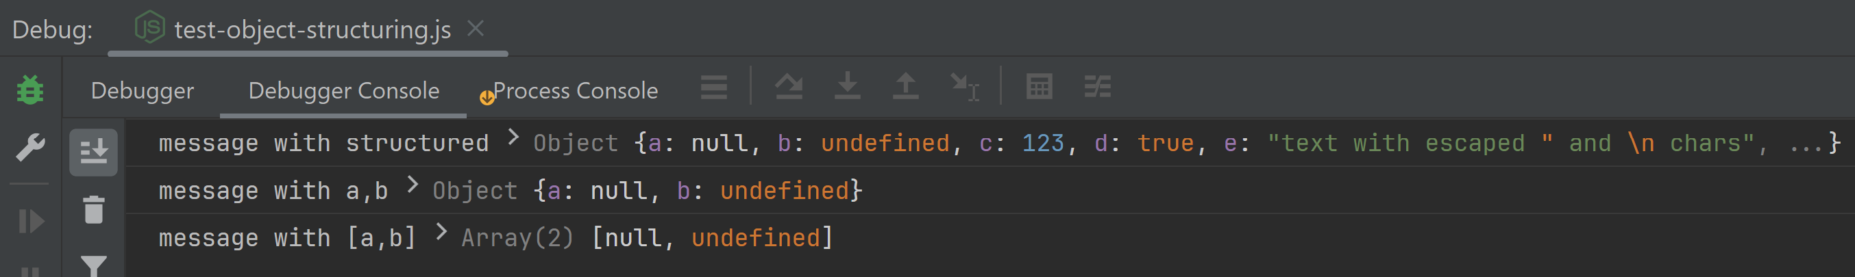
Example with Structured output from console.log()

Slide 21
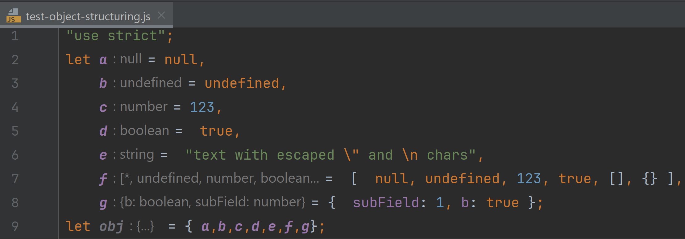
Object Creation from variables without reapeating "a":a, "b":b, simply {a,b}

Slide 22

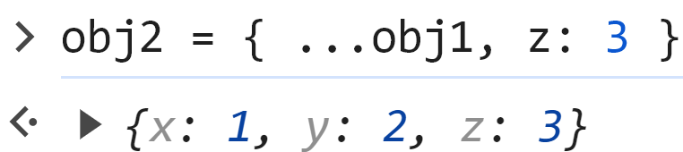
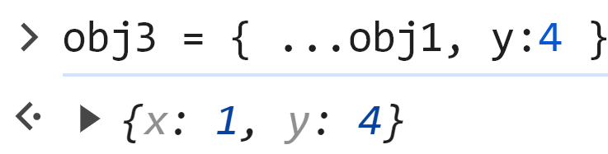
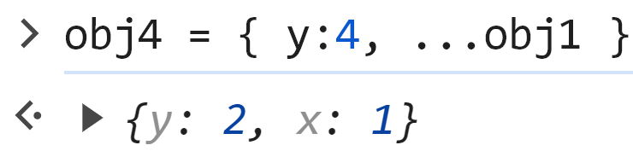
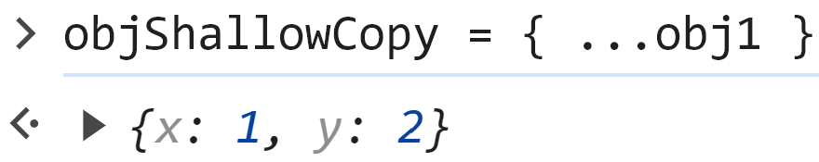
Object Spreading Operator
add all properties from obj1,
then complete with values
... then override with values
... order matters
(first define order, last override value)

Slide 23
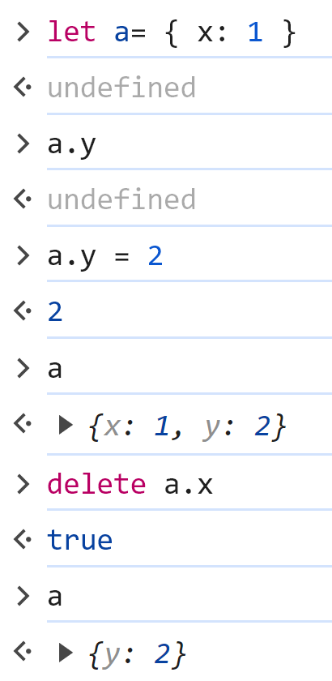
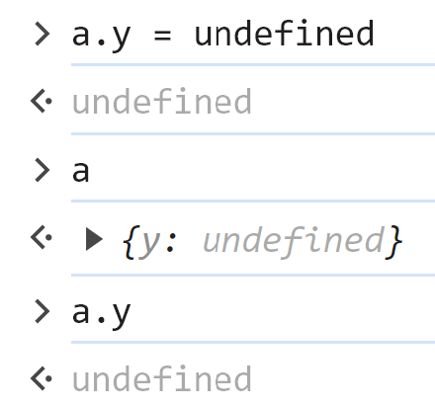
Undefined Field, delete obj.field
get unknown field
=> NO error, return undefined
add new field on first set
set field undefined
delete field

Slide 24
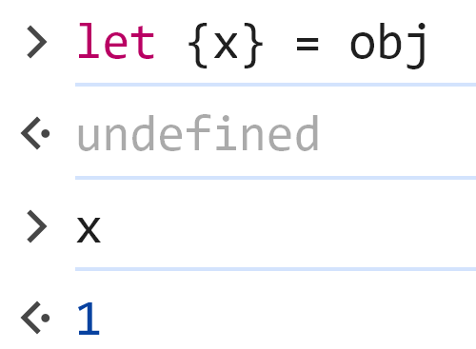
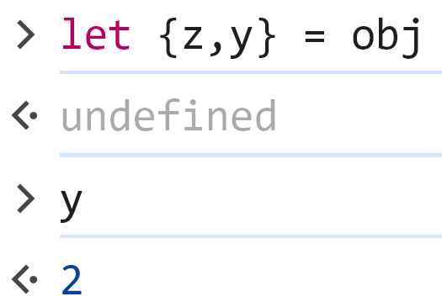
Object De-Structuring to Variables
extract property "x" from obj, assign to local variable x
can extract many properties partially
order does not matter, only names

Slide 25
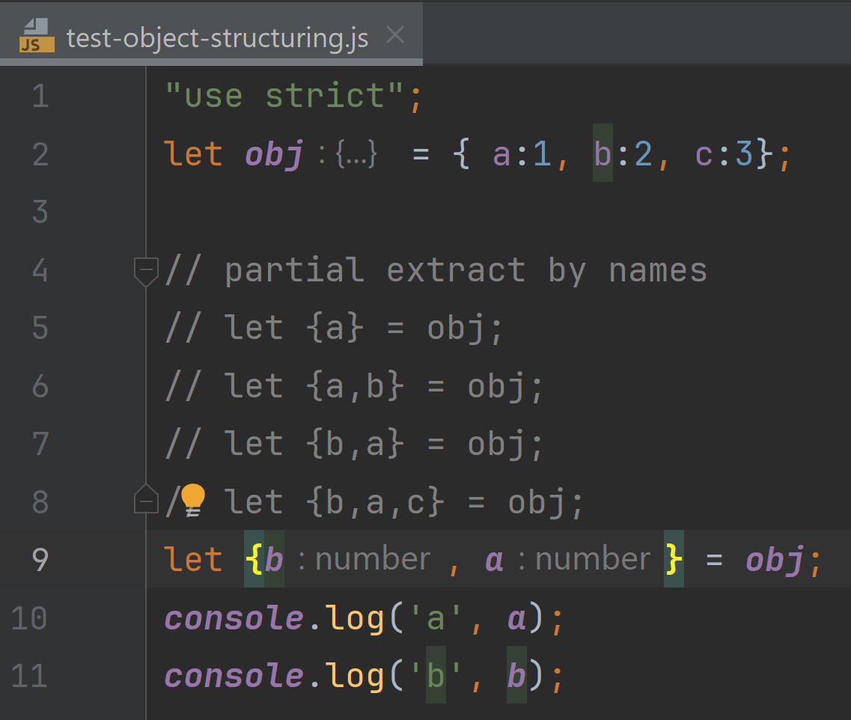
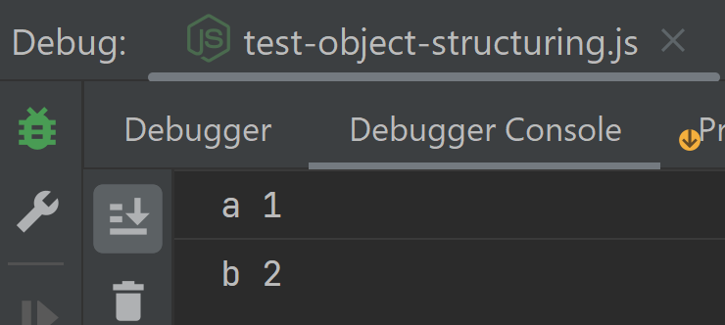
Object De-Structuring to variables

Slide 26
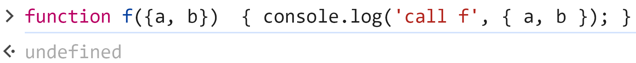
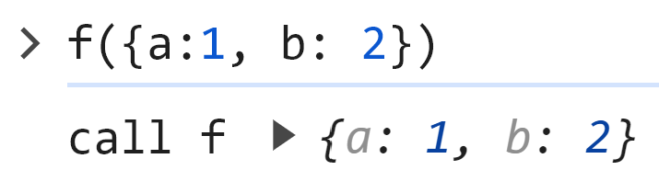
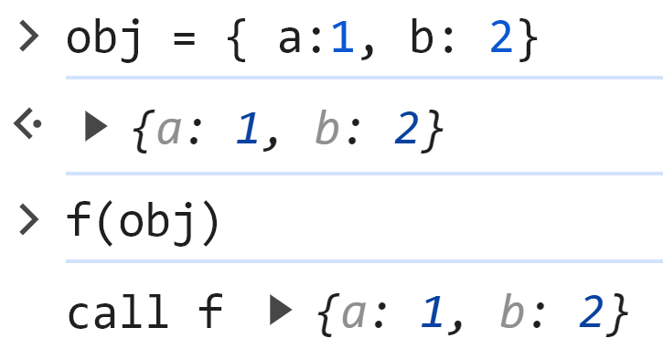
Object De-Structuring to Function Parameter

Slide 27
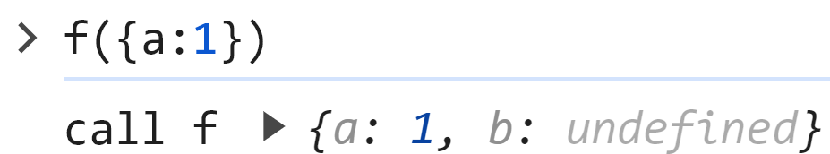
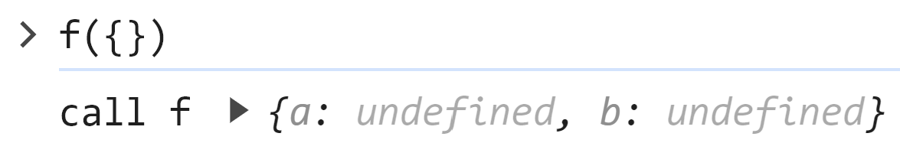
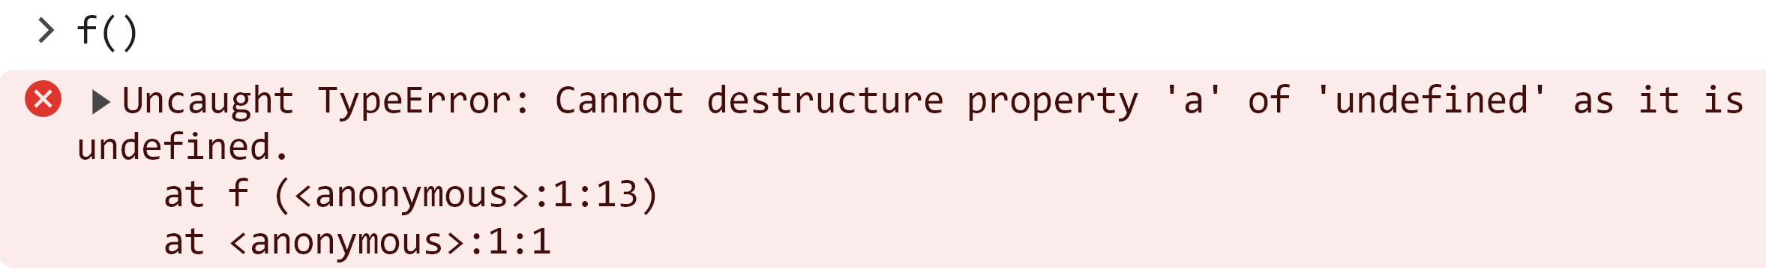
Function Param De-Structuring ... undefined
object param is defined, partially filled
ANNEXE
object param is defined, but empty
object param is undefined !

Slide 28
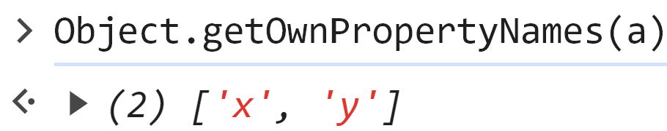
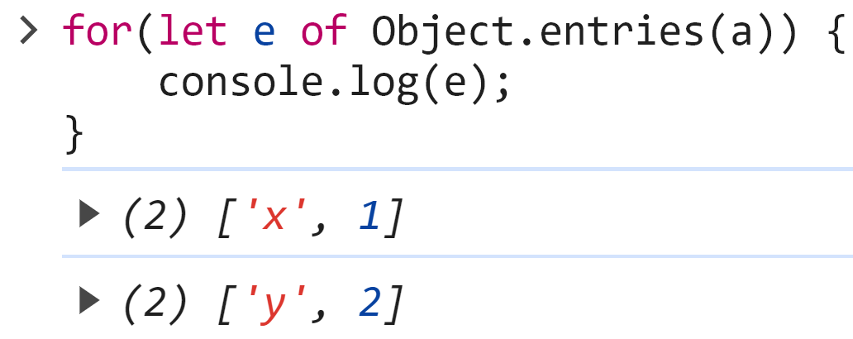
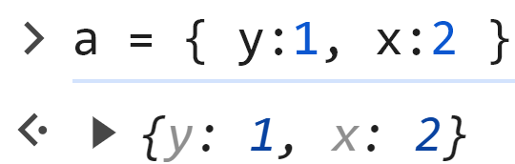
Iterating on Fields, field order, owned field
Equivalent Code in Java
ANNEXE
a.keySet()
a.entries()
notice order: y,x instead of x,y
a = new LinkedHashMap<String,Object>()
... (!= HashMap)

Slide 29
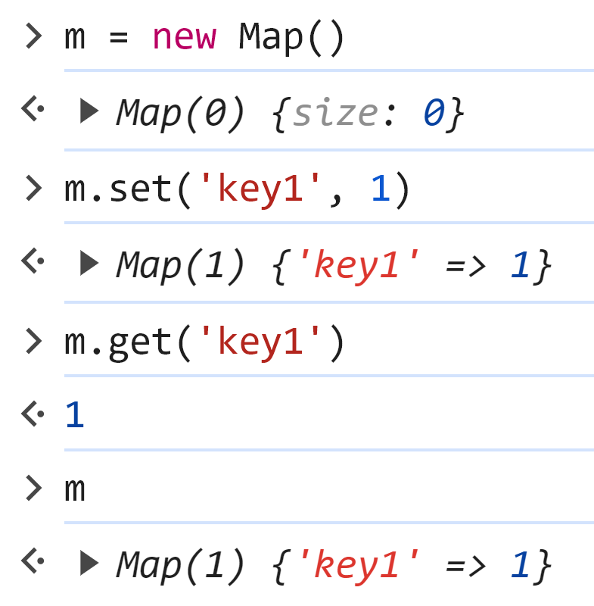
Notice, can use real "new Map" in JavaScript
ANNEXE

Slide 30


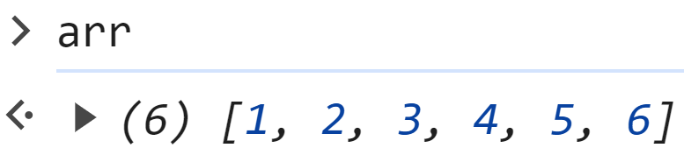

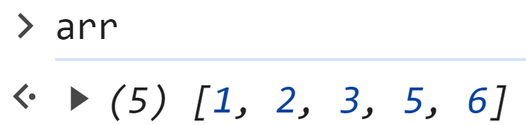
Array
Equivalent Code in Java
arr = new ArrayList<>(
Arrays.asList(1, 2, 3, 4, 5));
a.add(6);
a.removeAt(3);

Slide 31

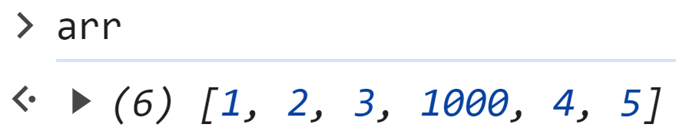
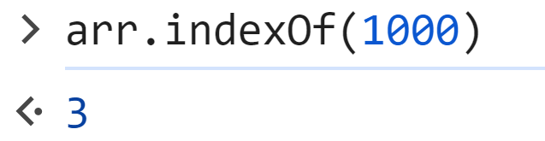
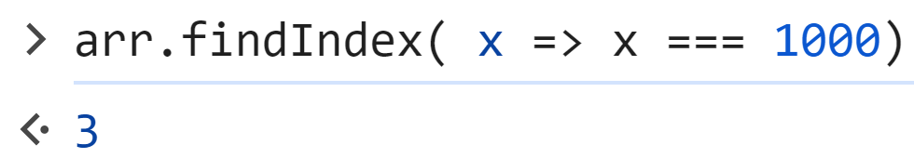
Array operations
Equivalent Code in Java
arr.insertAt(3, 1000);
arr.indexOf(1000);
no simple equivalent ?
arr.remove(1000)

Slide 32
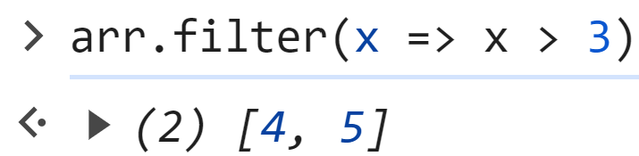
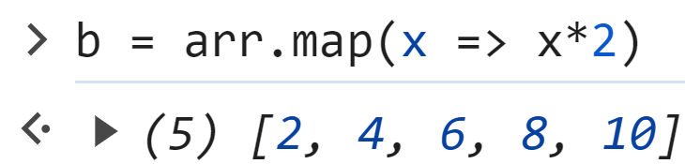
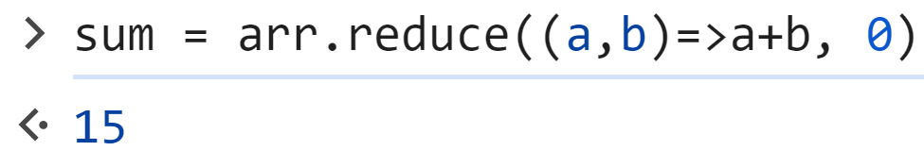
Array Functional Operations
Equivalent Code in Java
b = arr.stream()
.filter(x -> x > 3)
.collect(Collector.toList())
b = arr.stream()
.map(x -> x*2)
.collect(Collector.toList())
b = arr.stream()
.reduce(0, (a,b) -> a+b)

Slide 33

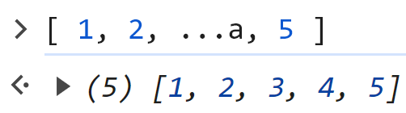
Array Spreading Operator

Slide 34
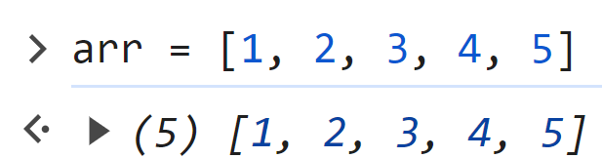
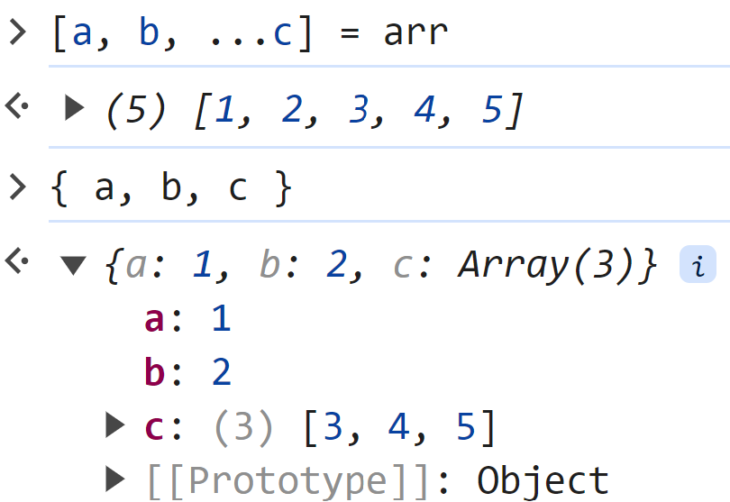
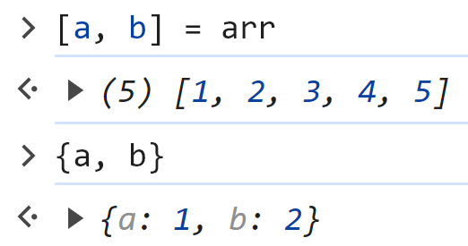
Array Destructuring to Variables

Slide 35
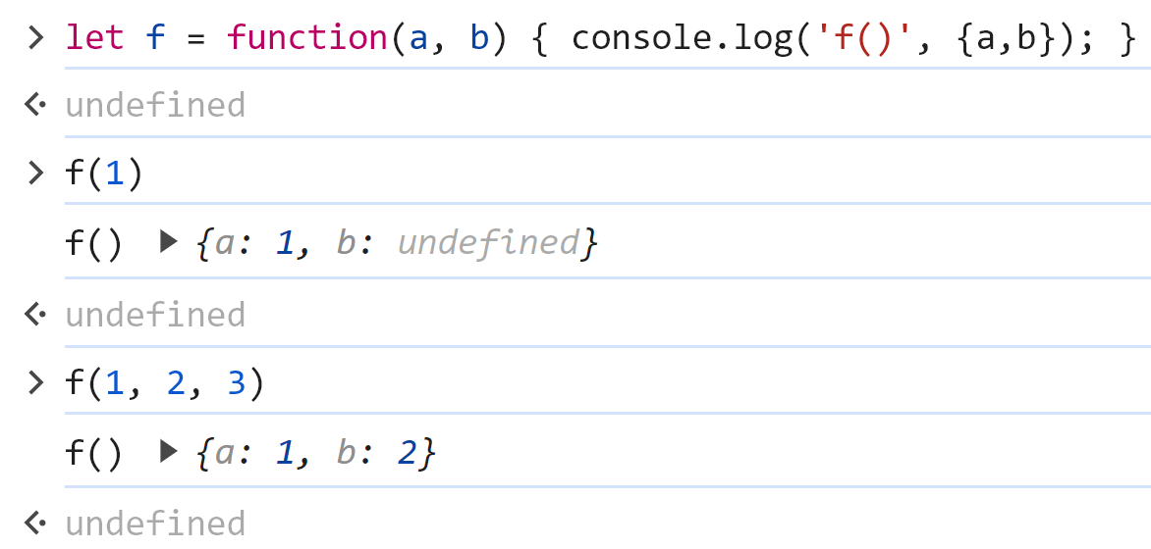
Functions

Slide 36
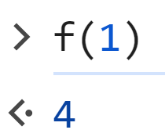
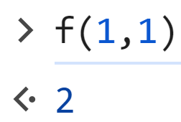
Function default parameter Value
call function without parameter "b" => using default
call function with explicit parameter override

Slide 37
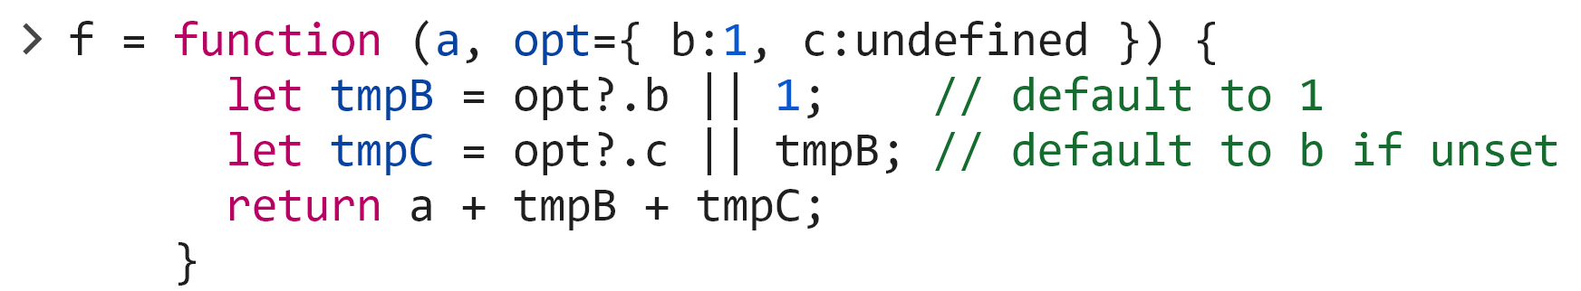
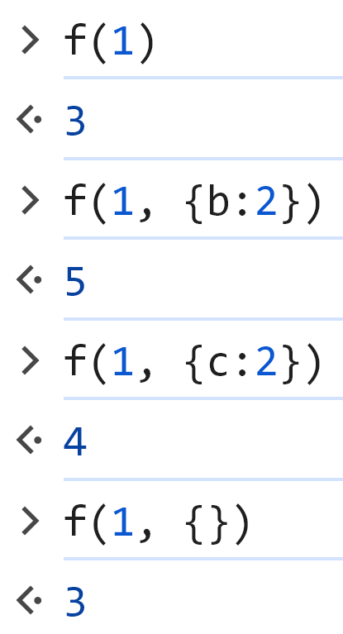
Idiomatic ("Strange") JS Code using default parameter options object

Slide 38


Idiomatic "Stange" JS Code destructuring param & default param
param
object destructuring
default value

Slide 39






Functions are Objects
object spreading on "function object" ! => empty by default
can assign field to "function object"
displaying "function object", still only show source code (no fields)
can get field from "function object"
object spreading
... all like object

Slide 40


Function <-> String source code

Slide 41

Arrow (Lambda) Function
arrow function with code block
arrow function with expression

Slide 42

Function used as field ~ method ? this = ??

Slide 43

"this" bounded to function

Slide 44

Function as "Class" Constructor

Slide 45


prototype
adding field (property / method) to object prototype => adding to all impacted instances

Slide 46
emulated class with Prototype (before EcmaScript2015)
using Typescript (transpiler to JavaScript)
class are emulated with prototype before EcmaScript2015
looks like class after ( but internally, still mutable prototype obects )

Slide 47




Class in JavaScript !
define a class
display class source
new object
(no constructor yet, default)

Slide 48



Class constructor
new call constructor
call forget to pass argument to constructor method! => using undefined

Slide 49

Class field / assignements from constructor
declare class with 2 fields: x, y
initialise only x
field y exist, but not assign from constructor

Slide 50
Comparison with TypeScript ... short syntax for field declaration + assignment
ONLY in TypeScript (yet)
class A { field4: string = '';
constructor(public field1: string, private field2: string, private readonly field3: string, param: string) { }
}
// type script implicit equivalent
class A { public field1: string; private field2: string; private readonly field3: string; field4: string = '';
constructor(paramField1: string, paramField2: string, paramField3: string,
param: string) { this.field1 = paramField1; this.field2 = paramField2; this.field3 = paramField3; }
}
// JavaScript equivalent
class A { field1; field2; field3; field4 = '';
constructor(paramField1, paramField2, paramField3,
param) { this.field1 = paramField1; this.field2 = paramField2; this.field3 = paramField3; }
}

Slide 51


Class Method

Slide 52

Class are just like prototype => Class are not immutable proof: removing declared method via prototype

Slide 53

Class <-> prototype ... methods can be added at runtime
calling newly created method on previous existing object instance
=> works !

Slide 54


"undefined is not a function"
Corresponding Errors in Java
NullPointerException
ArrayIndexOutOfBoundException
Corresponding Errors in C,C++,..
SegmentationFault
Bus Error
Memory Access Error

Slide 55


Method as field per instance !?? (instead of per prototype)
instanciating several objects
=> call several times "this.getZ = function() {..} "
redundant (duplicated) functions instances! may have huge performance/memory impact

Slide 56



Class property : get | set
call property getter
call property setter

Slide 57

Class inheritance
using sub-class and methods override is NOT (yet?) idiomatic code in JavaScript
but works "fine"
(without type check / immutability constraint)

Slide 58



Class static : method | field | get | set
call static property getter
call static function
call static property setter
get/set static field

Slide 59



Class statics : stored on prototype

Slide 60
OK there are "class", but class are not "Type" and still NO type-checking at compile-time
Mostly on any error, you will get :
Exception "undefined is not a function"

Slide 61
Type checking ? at "Compile Time" ??
add optional " : <typeDeclaration>" to variables
TypeScript = superset of JavaScript langage
a JavaScript file is a TypeScript file
(valid grammar, but maybe invalid type check)

Slide 62



Edit Js to add ": <type>" to variables Rename file ".js" to ".ts" TypeScript
": <type>" is not valid JavaScript
valid in TypeScript

Slide 63


Compile Time checking ...
valid in untyped JavaScript
but not in TypeScript

Slide 64

IntelliJ TypeScript : Recompile on changes

Slide 65


Js file generated from Ts file
expand to see
generated file

Slide 66

Transpile TypeScript = generate JS by mostly removing ": <typeDeclaration>"

Slide 67

Tsc (=TypeScript Compiler)

Slide 68

tsc --init

Slide 69

tsconfig.json using ES5 ... ES2023

Slide 70

Example Emulating class with ES5

Slide 71

JavaScript evolve (from TypeScript ESNext) ... example: have class since ES2015, after TS had

Slide 72
JavaScript has weird "var" visibility

Slide 73
JavaScript has weird "var" visibility "use strict"; // at first line But still weird

Slide 74
JavaScript has weird "var" visibility "use strict"; // at first line use Immediatly Invoked Anonymous Function But still weird

Slide 75
JavaScript has weird "var" visibility "use strict"; // at first line use Immediatly Invoked Anonymous Function use "let" or "const" instead of "var" use TypeScript

Slide 76


in "Standard Langages" 1/ declare, then 2/ init, then- 3/ use with scope = enclosing { block }

Slide 77

JavaScript has weird "var" visibility
What do you think ??
a/ does not "evaluate" / "run" / "compile"
b/ throws exception
c/ print "undefined"
d/ print "1"

Slide 78

Answer: d/ print 1 the scope of visibility if the enclosing function ( not the enclosing block)

Slide 79


without "use strict" ... NO need to decl "var"

Slide 80


with "use strict";

Slide 81


even stranger: use before declare in nested block

Slide 82

other strange "var" visibility

Slide 83

JavaScript has weird "var" visibility
declared "ok"
BUT not initialized yet => undefined !

Slide 84


work around for scope : "Immediatly Invoked Anonymous Function"

Slide 85




"let" | "const" ... as "var" replacement

Slide 86


"let" ( or "const") in same block

Slide 87


not init (ok in JS !) but does not compile in TypeScript

Slide 88
100 reasons you need TypeScript and will probably love it
everybody hate JavaScript, for million reasons,
but it does evolve

Slide 89
Spoiler Alert TypeScript is NOT "more efficient" than JS ... it is just typed-checked at Compile-Time then translated to JS at Runtime, you still have poor old Node.js or Web Browser

Slide 90
TypeScript Types
Primitive Types (for values) : any, null, undefined, boolean, number, string
Composite Types:
" | " Union (choice between types)
" & " combination of type constraint
"readonly" type modifier
Array
Interfaces : type constraint on existence of field / partial field in Object
" ? " Optional Field Type (for accepting "undefined")
Function, Class, Templates, etc.

Slide 91

any ?
any ... as name implies
= No Type checking !
To use TEMPORARILY while porting JS to Ts
Good Ts program(er)s should never use "any"

Slide 92

Union Type

Slide 93
Example usages ": Type |undefined" for un-initialized field
class A {
field1 : string|undefined; // OK but ugly ... why undefined type? because implicit undefined value !
field2 : string; // compile ERROR !! "undefined is not assignable to string"
field3: string = 'text'; // OK field assigned to string value
field4 = 'text'; // OK field assigned, so field type to implicitly infered to ":string"
field5: string; // ok with assignment next in constructor
constructor() { this. field5 = 'text';
}

Slide 94

Force type-check with "!!"

Slide 95

Duck Typing

Slide 96

Structural Interface Typing, Combine Partial
= type inferred (displayed by IntelliJ), NOT edited in file

Slide 97

Type Checking "missing property" in Interface

Slide 98
TypeScript...
TypeScript is AWESOME !
allow to write very concise functional / json structured code

Slide 99
What about JSX / TSX ? X for (xml) eXtension ?

Slide 100

React ... JS functions for rendering html
https://react.dev/

Slide 101

function() { return (<html> </html>); }

Slide 102

<html> with templated JS { someJS() } </html>

Slide 103
Not valid JavaScript / TypeScript ! need to be "translated" to JavaScript

Slide 104

Function instead of "Class" object instances ! where to store field state?

Slide 105

And How to pass input values from parent to child?

Slide 106
... the start of the ending ! inventing other workaround: React Redux & many more ... MobX, React State,..

Slide 107
Babel: translate JSX to JS (with react/jsx-runtime functions calls)

Slide 108

Babel Translated Code
https://babeljs.io/docs/babel-plugin-transform-react-jsx

Slide 109
Why not having N x 2 files for using 2 different langages: Html != TS
When developping with N small components
you may need to switch between 2 x N file : comp1.ts, comp1.html, comp2.{js|html}, ..
example in Angular: $ ng generate component foo
=> get 2 files: foo.component.ts + foo.component.html
You may also inline the html in the ts file (template='<h1>..' instead of templateUrl='./file-path.ts' )
@Component(selector='foo'
template=`
<h1>... some long html</h1>
multi-lines
`
)
You may also declare several components (+ associated template) in a single .ts file

Slide 110
Web Editor Support
Fortunatly, good editors
(IntelliJ Ultimate or IntelliJ WebStorm, VisualCode, etc.. )
support contextual
TypeScript edit features within { code() }
& Html edit features within <element> .. </element>

Slide 111

Integrating React in a Web Page [1/2]

Slide 112

Integrating React in a Web Page [2/2]

Slide 113

JS -> JSX, TypeScript -> TSX

Slide 114
Take Away
JavaScript is a scripting langage (not suited for large code base app)
but is the de-facto standard Runtime for Web
TypeScript is the standard developper langage for generating JavaScript, with type checks
JSON is the standard data format for Http Rest API
JSX/TSX are eXtensions of JS/TS for React
... not a standard, only a fashion as of 2024.
other frameworks exist: Angular or VueJs are richer/simpler alternatives for data-binding + routes + ...

Slide 115
Next Steps
- JavaScript, TypeScript, JSON, TSX
- Interactions between Html (DOM) / Https / JavaScript
- Angular Web Framework
- Building Rest JSON API, and SPA Web application
- ..

